Slide 1
ONLINE CAB BOOKING SYSTEM
Babu Madhav Institute of Information Technology
5 Years Integrated M.Sc. (IT)
Group No : 5
NIDHI N. PATEL (201706100110067)
URVI R. PATEL (201706100110143)
Guided by Ms. KAJAL PATIL

Slide 2
Index
Project definition
SRS
Use Case Diagram
Activity Diagram
Data Dictionary
User Interface

Slide 3
Project Definition
The Online Cab Booking System will help to book a cab in which customer can book a cab based on category, price and place.

Slide 4
SRS(Software Requirement Specification)
1. Purpose
2. Scope
3. Identification of need
4. Technology Used
5. Functional Requirements
6. Non-Functional Requirements
7. Modules
8. User Characteristics

Slide 5
Purpose
The purpose of the project is to develop a general-purpose e-booking business where cab can be booked from the comfort of home through the internet.

Slide 6
Scope
The system is only for Gujarat cities which are Vapi, Valsad, Navsari, Vyara, Bardoli, Surat, Bharuch and Vadodara. It will be available only to the registered user.

Slide 7
Identification Of Need
Customer can book cab without going out.
Some Areas are not covered by bus so cab can go there.

Slide 8
Technology Used
Front End: HTML, CSS, Bootstrap, Visual Studio 2010(ASP.NET)
Back End: SQL Server 2008 , Umlet
Document Tool: Microsoft Word 2010

Slide 9
Functional Requirements
Can register
Cab login
Can change password
Can update profile
Can deactivate profile
Select cab type
Enter source
Enter destination
Enter pickup time
View rates
View offers
Apply offers
View bill
Select payment mode
View destination
View driver details
Cancel booking
Can give feedback
Generate report
View feedback
Add offers
Update offers
De-active offers
add city
modify city
delete city
View source
add driver
Can payment
view booking

Slide 10
Non Functional Requirements
Responsive:
By using bootstrap, the system will be device friendly.
Security:
By applying MD5

Slide 11
Modules
Manage Offers:
Add offer
Update offer
Delete offer
View offer
Manage Profile
Update details
Delete details
View details
Manage Booking:
Book cab
Confirm booking
Cancel booking
Update booking
View booking
Manage Rates:
Add rates
Update rates
Delete rates
View rates
Search rates

Slide 12
Modules
Give feedback
Manage Payment:
Make payment
Cancel payment
Manage Tracking:
View source
View destination
Generate report:
Daily report
Monthly report
Yearly report

Slide 13
User Characteristics
ADMIN :
Admin can login into the system.
Admin can view details of registered customers.
Admin can view registered car details.
Admin can view registered driver details.
Admin can manage rates.
Admin can manage offers.
Admin can generate report.
Admin can send message to particular driver or customer.
Admin can view customer feedback.

Slide 14
User Characteristics
DRIVER:
Driver can register into to the system.
Driver can login into the system.
Driver can manage it’s profile.
Driver can manage its car and its details.
Driver can update its location and it’s status.
Driver can view allocated customer’s required details while booking.
Driver can view customer's feedback.
Driver can view it’s inbox messages sent by admin.

Slide 15
User Characteristics
CUSTOMER:
Customer can register into the system.
Customer can login into the system.
Customer can book a cab.
Customer can view and apply offers.
Customer can manage it’s profile.
Customer can view bill.
Customer can track the cab allocated to .
Customer can give feedback.

Slide 16
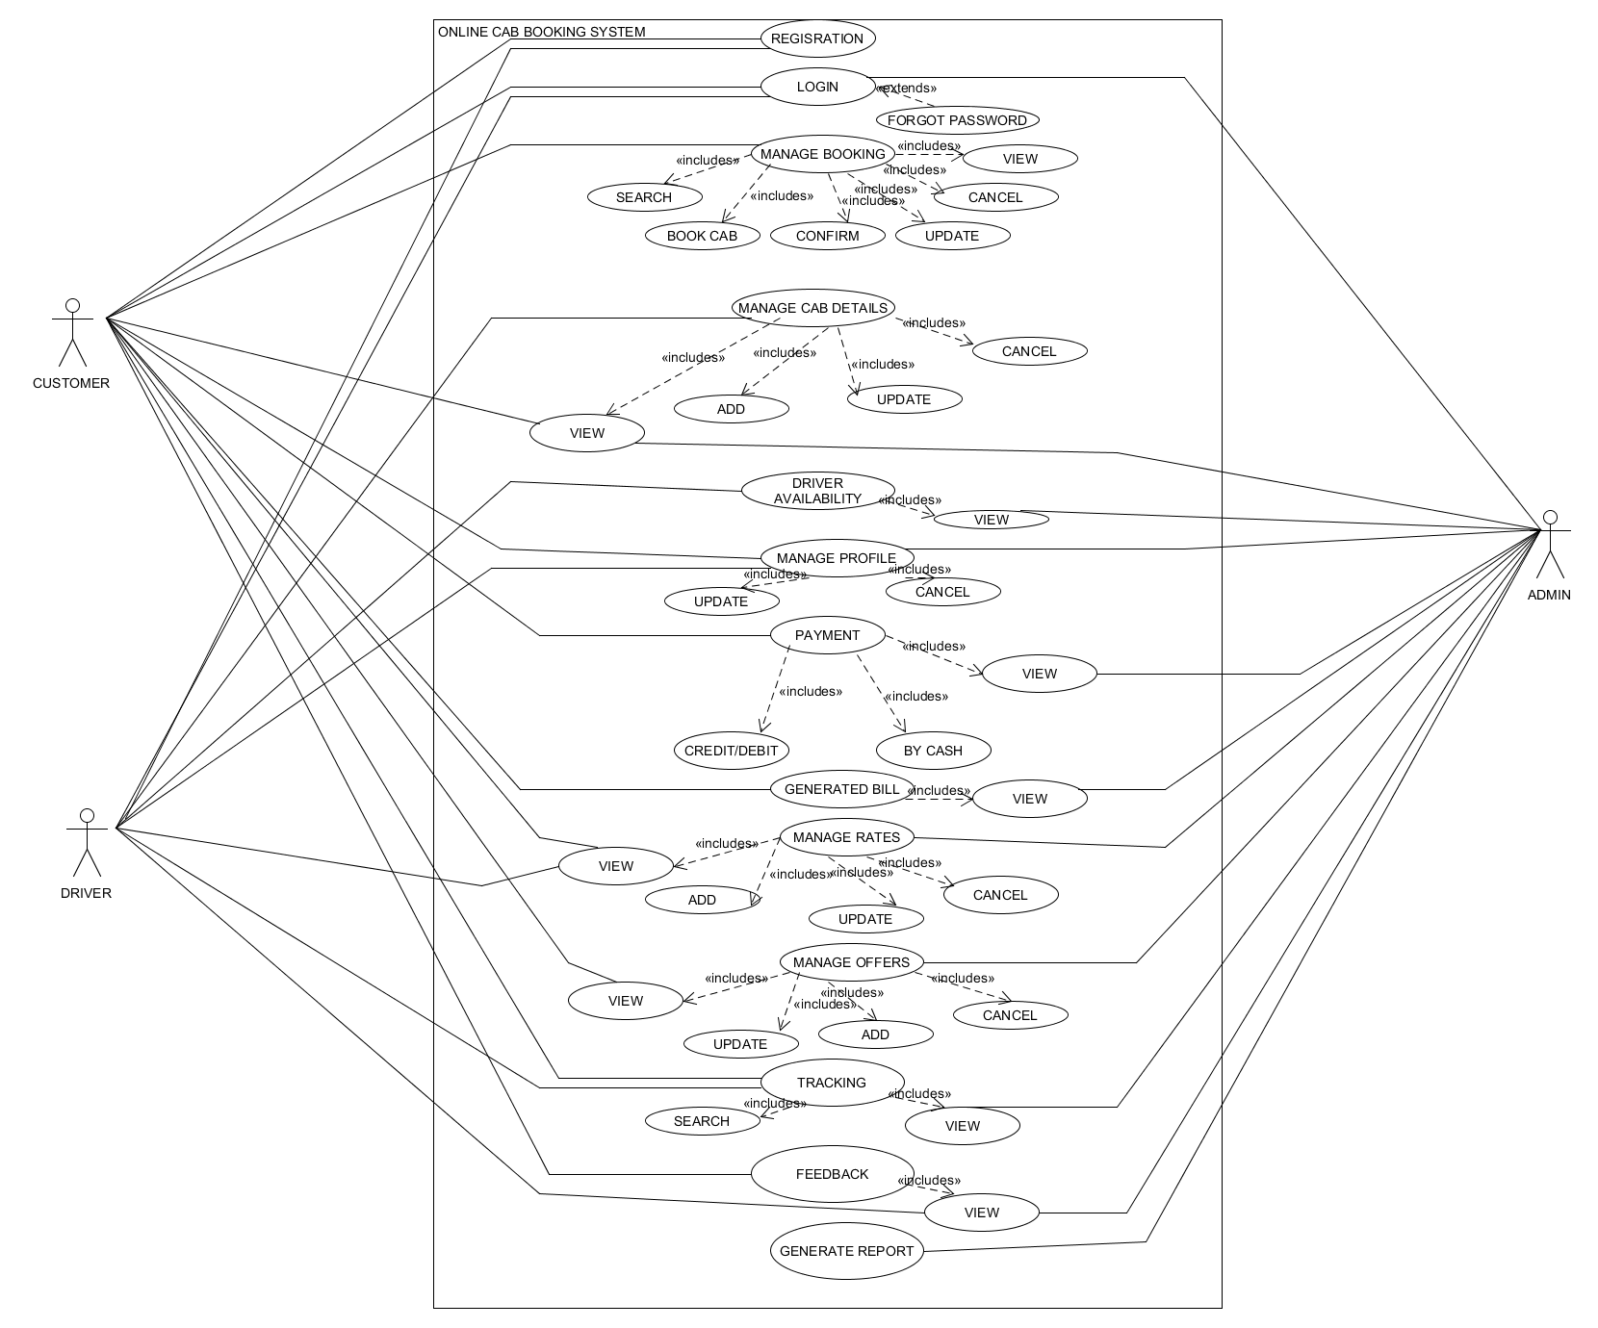
Use Case

Slide 17
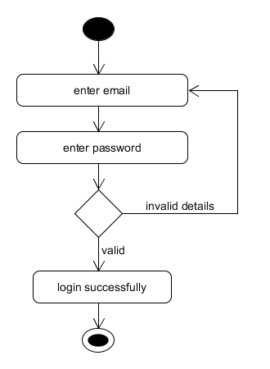
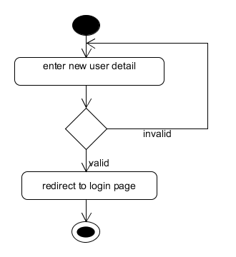
Activity Diagram
Registration Login

Slide 18
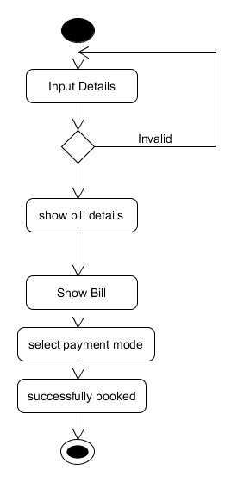
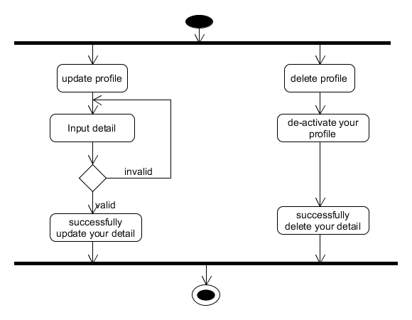
Activity Diagram
Manage booking:
Manage profile

Slide 19
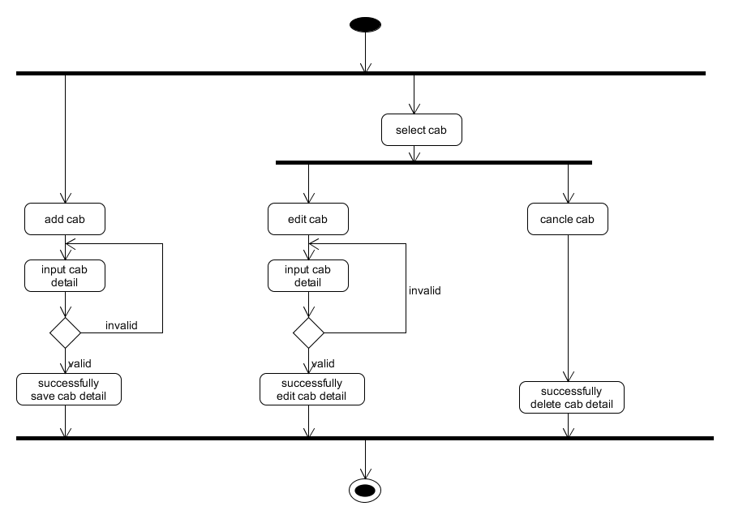
Activity Diagram
Manage cab details:

Slide 20
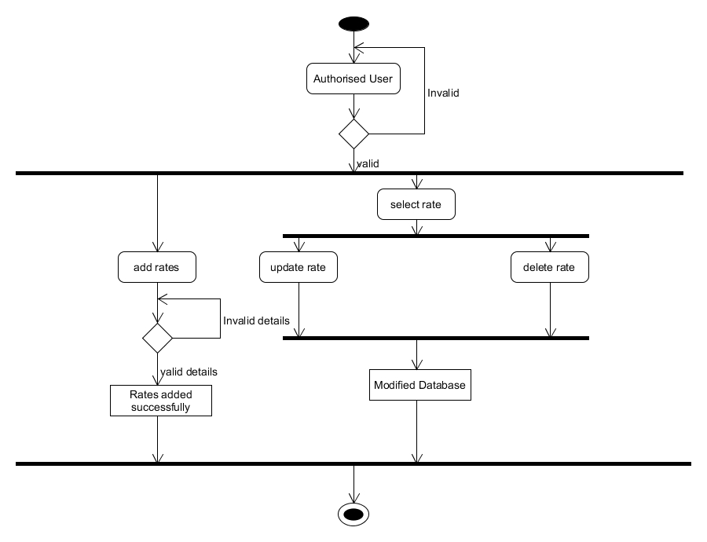
Activity Diagram
Manage Rates:

Slide 21
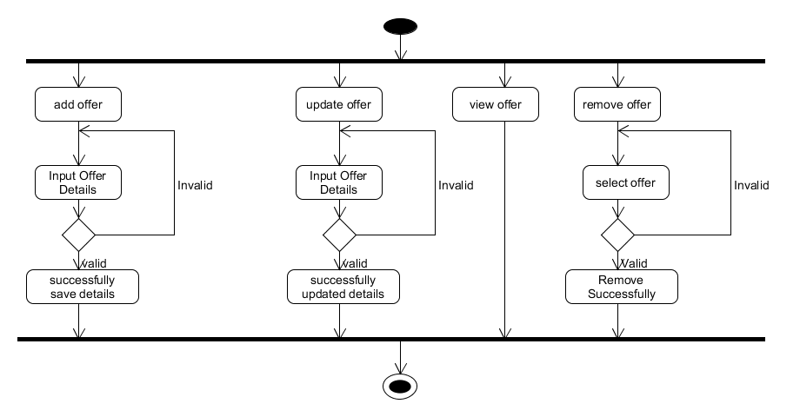
Activity Diagram
Manage Offers:

Slide 22
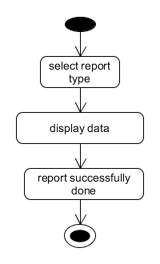
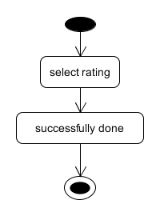
Activity Diagram
Generate Report Feedback

Slide 23
Data Dictionary
No. | Name
1 | Tbl_CustomerDetails
2 | Tbl_DriverDetails
3 | Tbl_CabDetails
4 | Tbl_Offers
5 | Tbl_Feedback
6 | Tbl_CityCabBooking
7 | Tbl_RentalCabBooking
8 | Tbl_OutStationCabBooking
9 | Tbl_Rates
10 | Tbl_Payment
11 | Tbl_City
12 | Tbl_Bill
13 | Tbl_CustomerLogin
14 | Tbl_DriverLogin
Total Tables: 14

Slide 24
Data Dictionary
Table Name : Tbl_CustomerDetails
Field Name | Data Type | Field Size | Constraints
CustomerId | integer | - | Primary key, auto_increment
CustomerName | Varchar | 50 | Not null
CustomerEmail | Varchar | 60 | Not null
CityId | Integer | - | Foreign key
CustomerAddress | Varchar | 10 | Not null
CustomerPincode | Integer | - | Not null
CustomerContactNo | Varchar | 10 | Not null

Slide 25
Data Dictionary
Table : Tbl_DriverDetails
Field Name | Data Type | Field Size | Constraints
DriverId | integer | - | Primary key, auto_increment
DriverName | Varchar | 50 | Not null
DriverContactNo | varchar | 10 | Not null
DriverEmail | Varchar | 60 | Not null
DriverPincode | Integer | - | Not null
DriverBirthDate | Date | - | Not null
DriverJoinDate | Date | - | Not null
DriverAge | Integer | - | Not null
DriverAddress | Varchar | 70 | Not null
CityId | Integer | - | Foreign key
DriverType | Varchar | 10 | Not null
CabId | Integer | - | Foreign key
DriverTotalRides | Integer | - | Not null
DriverStatus | Varchar | 10 | Not null
DriverCamision | Float | - | Not null

Slide 26
Data Dictionary
Table: Tbl_Feedback
Field Name | Data Type | Field Size | Constraints
FeedBackId | Integer | - | Primary key , auto_increment
CustomerId | Integer | - | Foreign key
FeedBack | Varchar | 80 | Not null
Rating | varchar | 5 | Not null
DateAndTime | Date | - | Not null

Slide 27
Data Dictionary
Table : Tbl_Offers
Field Name | Data Type | Field Size | Constraints
OfferId | Integer | - | Primary key , auto_increment
OfferName | Varchar | 50 | Not null
Description | Varchar | 80 | Not null
StartingDate | Date | - | Not null
EndingDate | Date | - | Not null

Slide 28
Data Dictionary
Table: Tbl_CityCabBooking
Field Name | Data Type | Field Size | Constraints
CityCabId | Integer | - | Primary key , auto_increment
CustomerId | Integer | - | Foreign key
CityId | Integer | - | Foreign key
Source | Varchar | 50 | Not null
Destinantion | Varchar | 50 | Not null
pickUpTime | Date | - | Not null
TotalPersond | Integer | - | Not null
OfferId | Integer | - | Foreign key
BillId | Integer | - | Foreign key

Slide 29
Data Dictionary
Table : Tbl_OutStationCabBooking
Field Name | Data Type | Field Size | Constraints
OutStationCabId | Integer | - | Primary key, auto_increment
CustomerId | Integer | - | Foreign key
CityId | Integer | - | Foreign key
Source | Varchar | 50 | Not null
Destination | Varchar | 50 | Not null
ToatlPersons | Integer | - | Not Null
NoOfDays | Integer | - | Not Null
pickUpTime | Date | - | Not null
TotalPersond | Integer | - | Not null
DriverId | Integer | - | Foreign key
CabId | Integer | - | Foreign key
OfferId | Integer | - | Foreign key
BillId | Integer | - | Foreign key

Slide 30
Data Dictionary
Table : Tbl_RentalCabBooking
Field Name | Data Type | Field Size | Constraints
RentalCabId | Integer | - | Primary key, auto_increment
CustomerId | Integer | - | Foreign key
CityId | Integer | - | Foreign key
Source | Varchar | 50 | Not null
Destination | Varchar | 50 | Not null
ToatlPersons | Integer | - | Not Null
NoOfDays | Integer | - | Not Null
pickUpTime | Date | - | Not null
ReturnTime | Date | - | Not Null
TotalPersond | Integer | - | Not null
DriverId | Integer | - | Foreign key
CabId | Integer | - | Foreign key
OfferId | Integer | - | Foreign key

Slide 31
Data Dictionary
Table: Tbl_Rates
Field Name | Data Type | Field Size | Constraints
RateId | Integer | - | Primary key, auto_increment
CabType | varchar | 50 | Not null
Kilometer | Integer | - | Not null
Amount | Float | - | Not null

Slide 32
Data Dictionary
Table : Tbl_Payment
Field Name | Data Type | Field Size | Constraints
PaymentId | Integer | - | Primary key, auto_increment
PaymentType | varchar | 50 | Not null
Table : Tbl_City
Field Name | Data Type | Field Size | Constraints
CityId | Integer | - | Primary key, auto_increment
CityName | varchar | 50 | Not null

Slide 33
Data Dictionary
Table : Tbl_BillTable
Field Name | Data Type | Field Size | Constraints
BillId | Integer | - | Primary key, auto_increment
CustomerId | Integer | - | Foreign key
OfferId | Integer | - | Foreign key
PaymentId | Integer | - | Foreign key
TotalKilometers | Integer | - | Not null
RateId | Integer | - | Foreign key
advanceAmt | float | - | Not Null

Slide 34
Data Dictionary
Table : Tbl_CustomerLogin
Table : Tbl_DriverLogin
Field Name | Data Type | Field Size | Constraints
CustomerId | Integer | - | Foreign key
Password | varchar | 100 | Not null
Field Name | Data Type | Field Size | Constraints
DriverId | Integer | - | Foreign key
Password | varchar | 100 | Not null

Slide 35
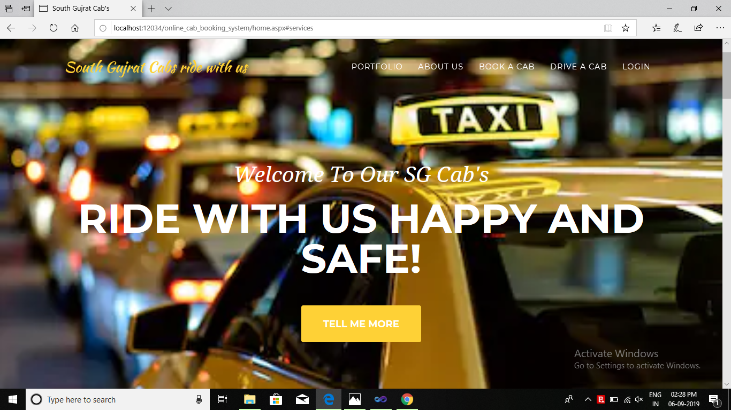
User Interface

Slide 36
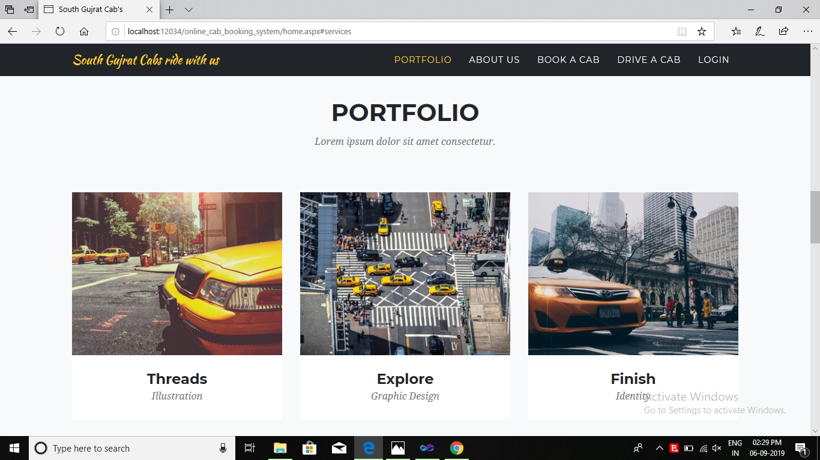
Home Page-Portfolio

Slide 37
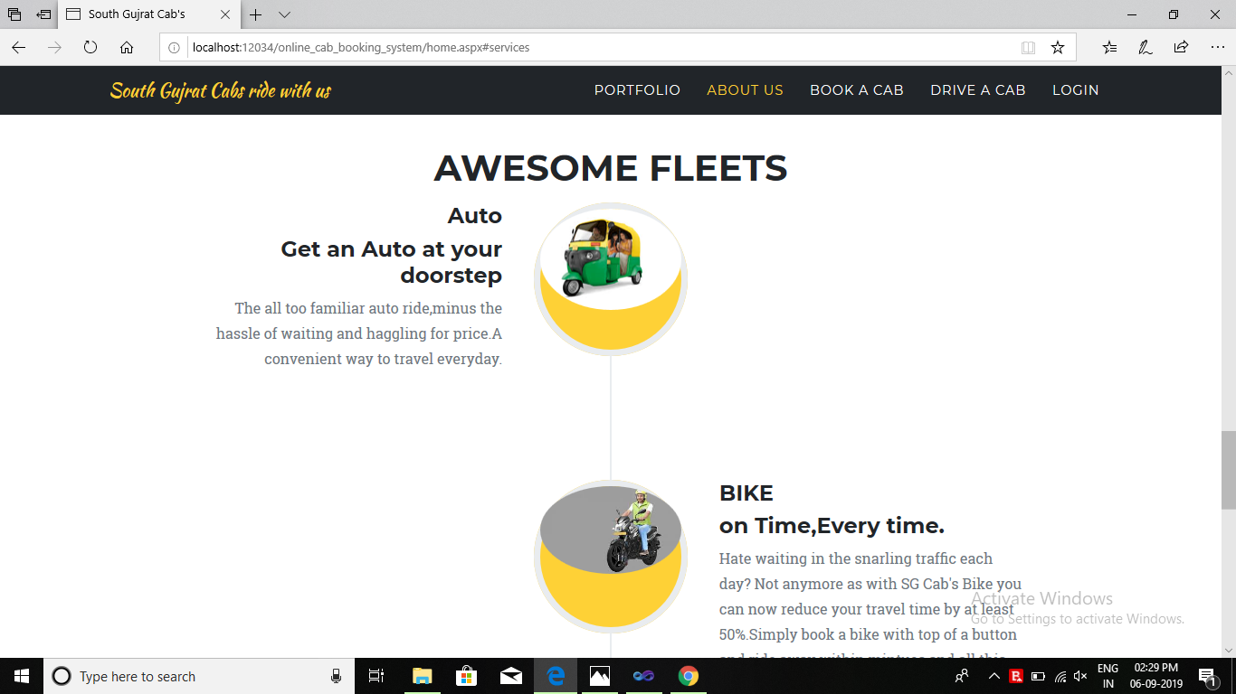
Home Page-About Us

Slide 38
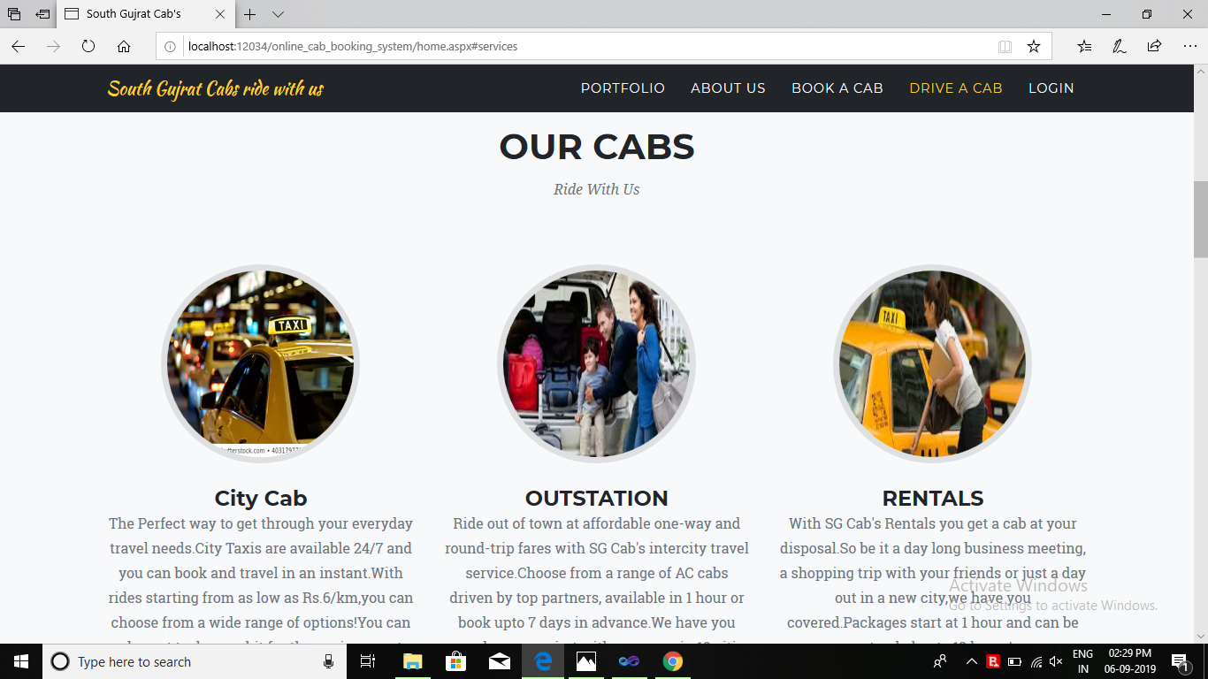
Home Page-About Us

Slide 39
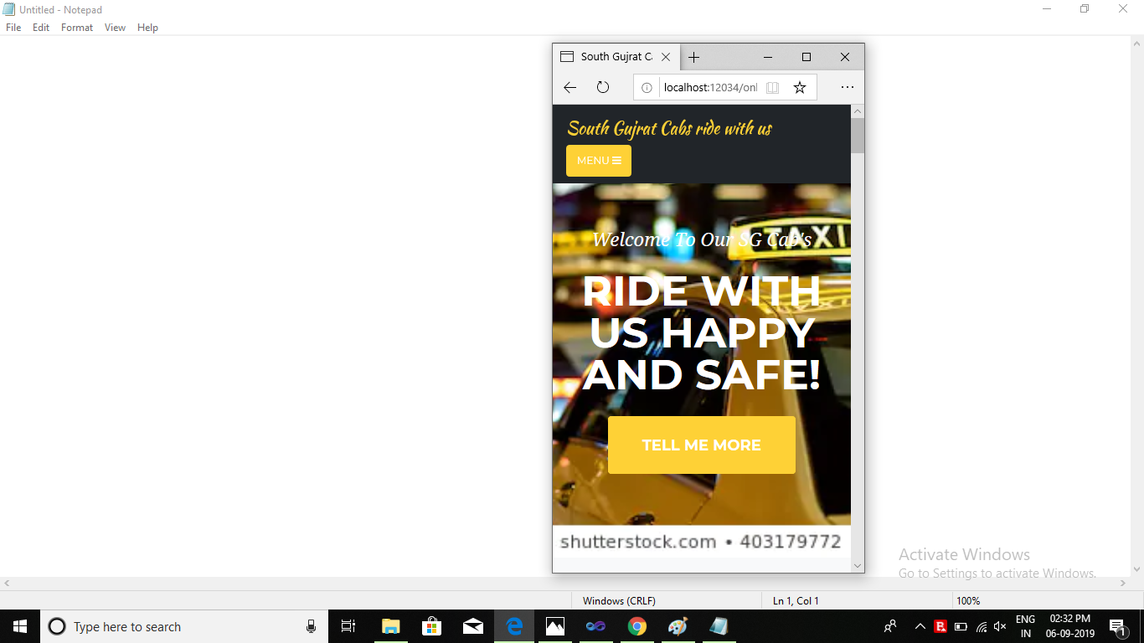
System is responsive

Slide 40
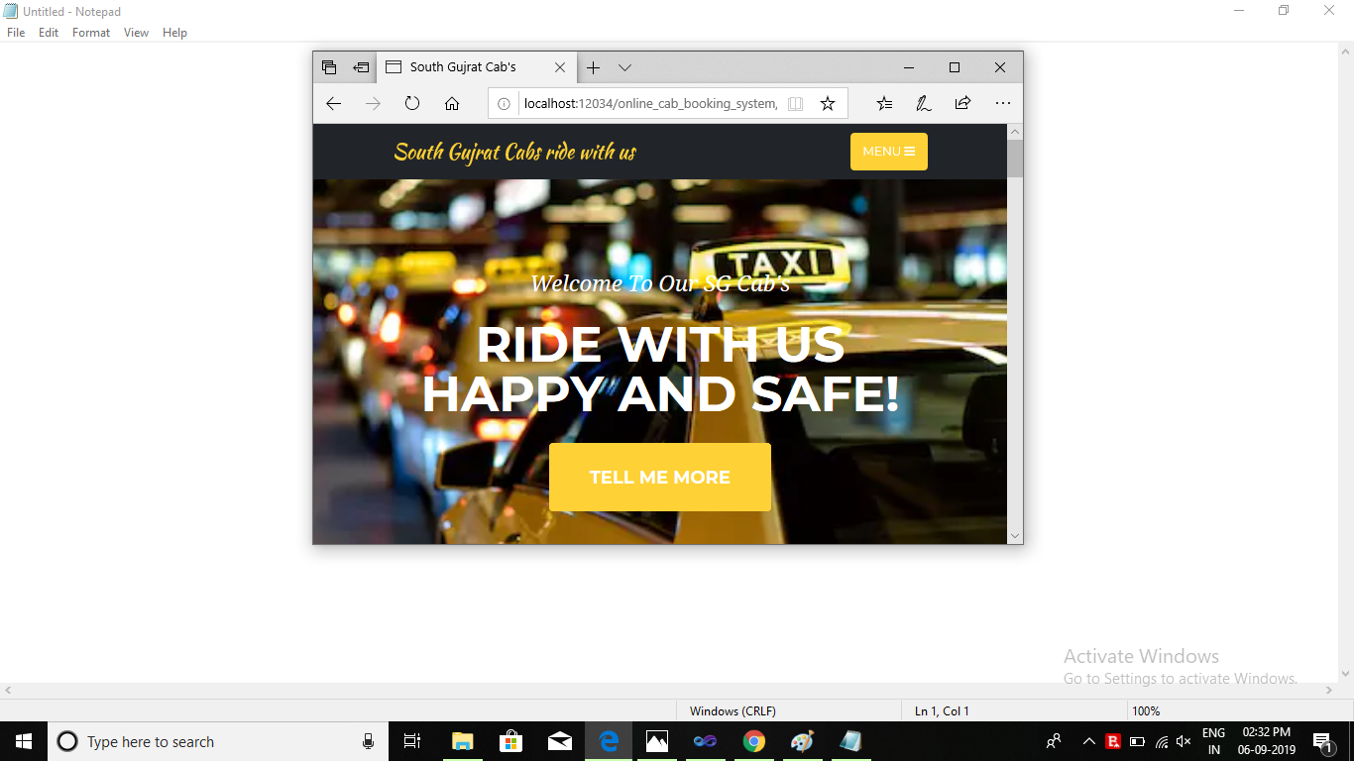
System is responsive

Slide 41
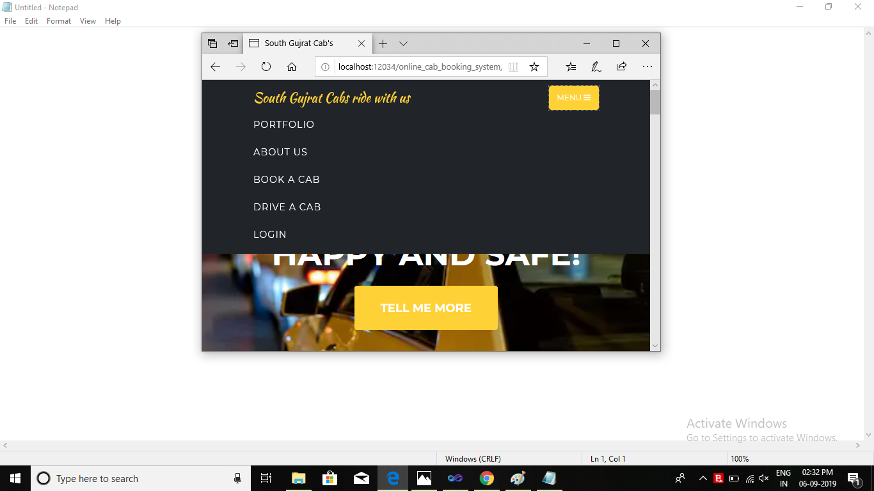
System is responsive

Slide 42
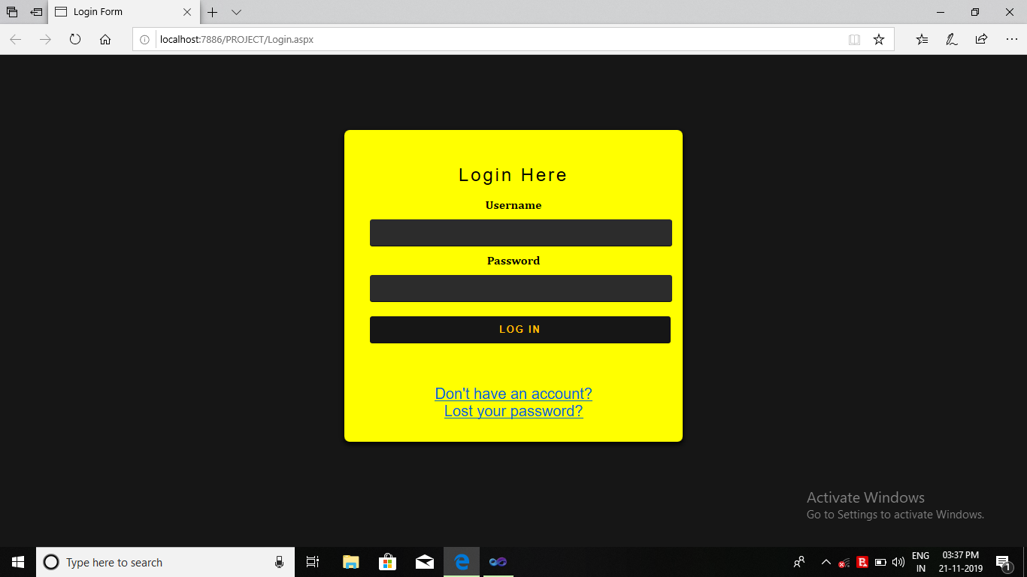
Login Page

Slide 43
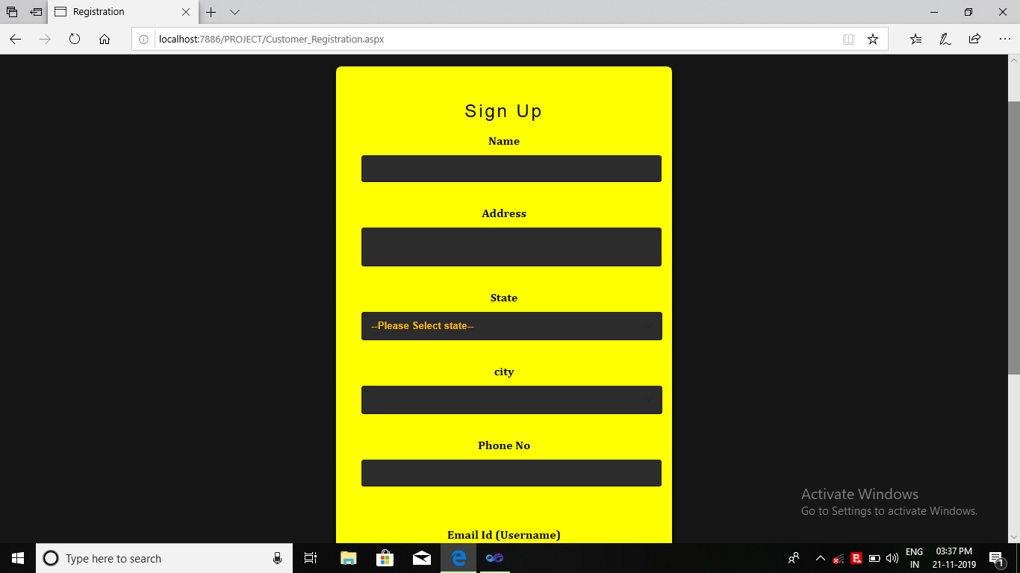
Registration Page

Slide 44
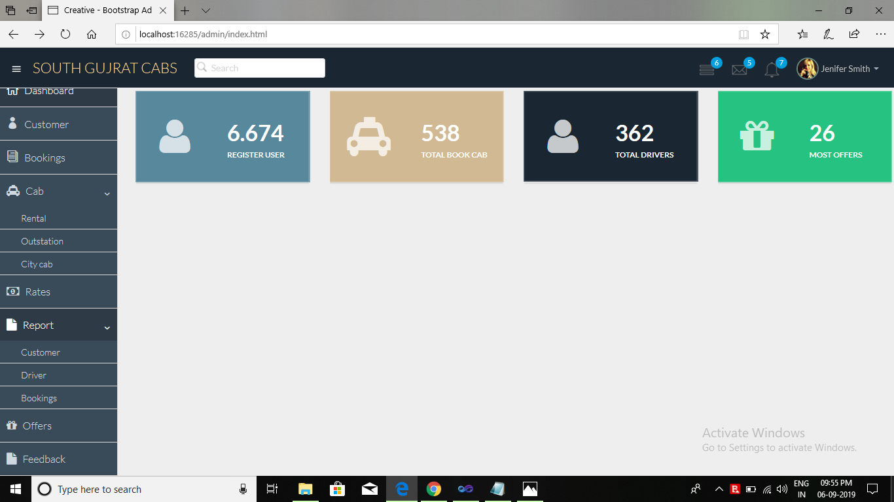
Admin Dash Board (Mater Page)

Slide 45
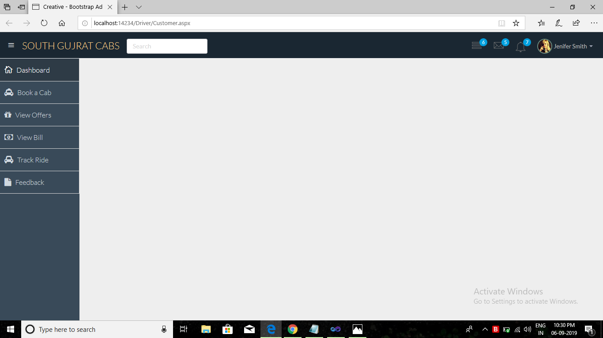
Customer Dash Board (Mater Page)

Slide 46
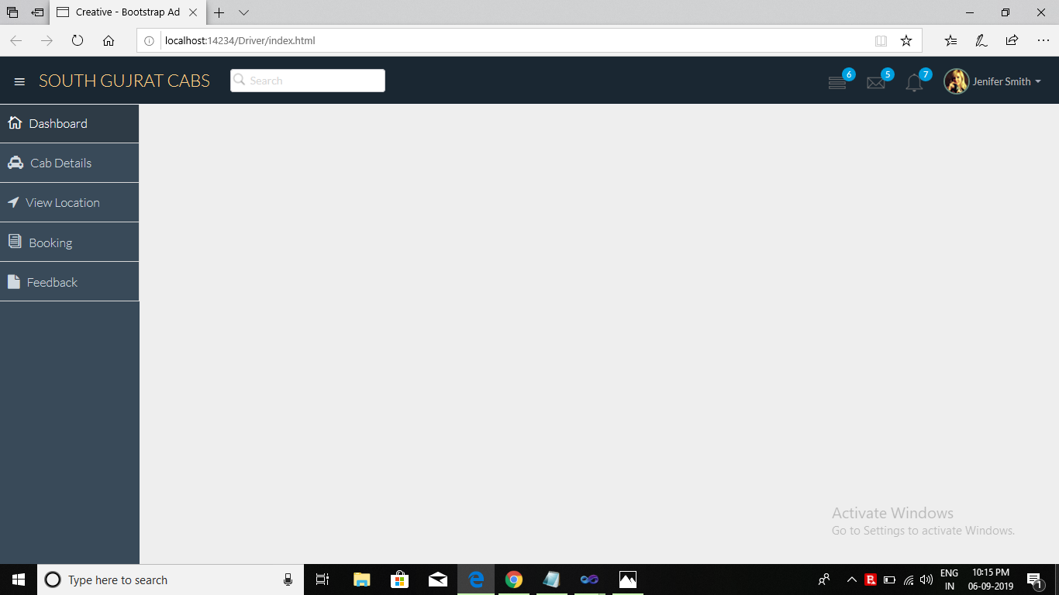
Driver Dash Board (Mater Page)

